Slide 1

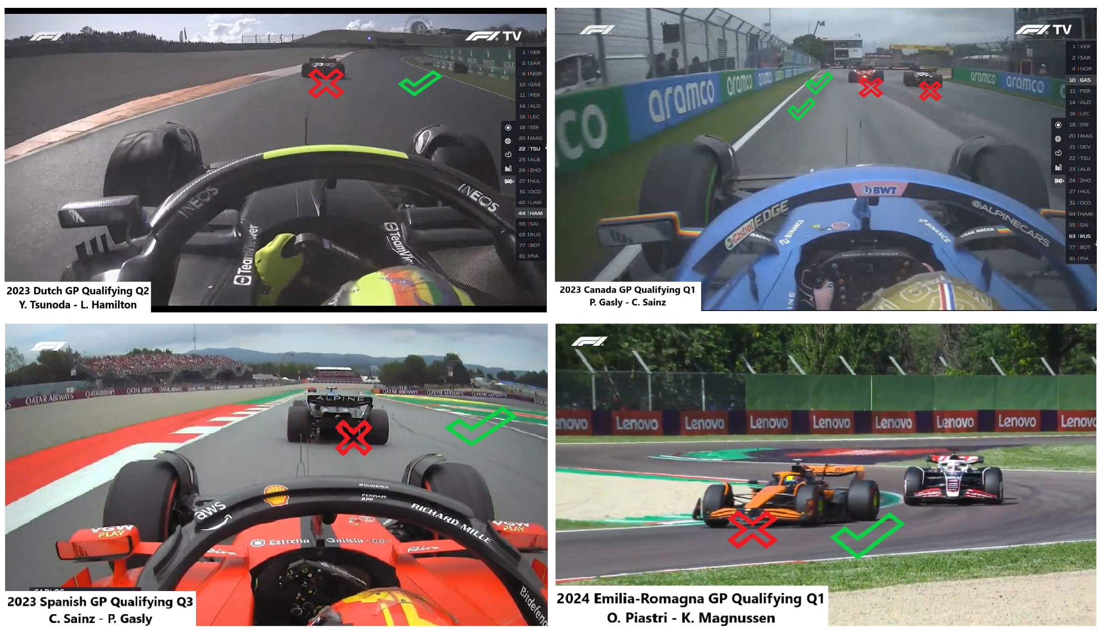
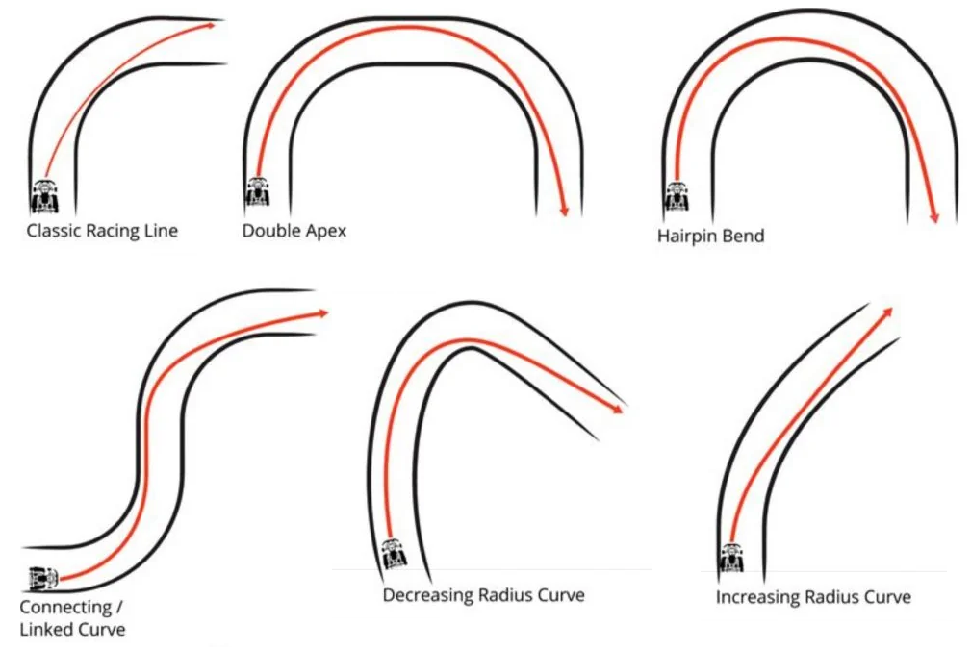
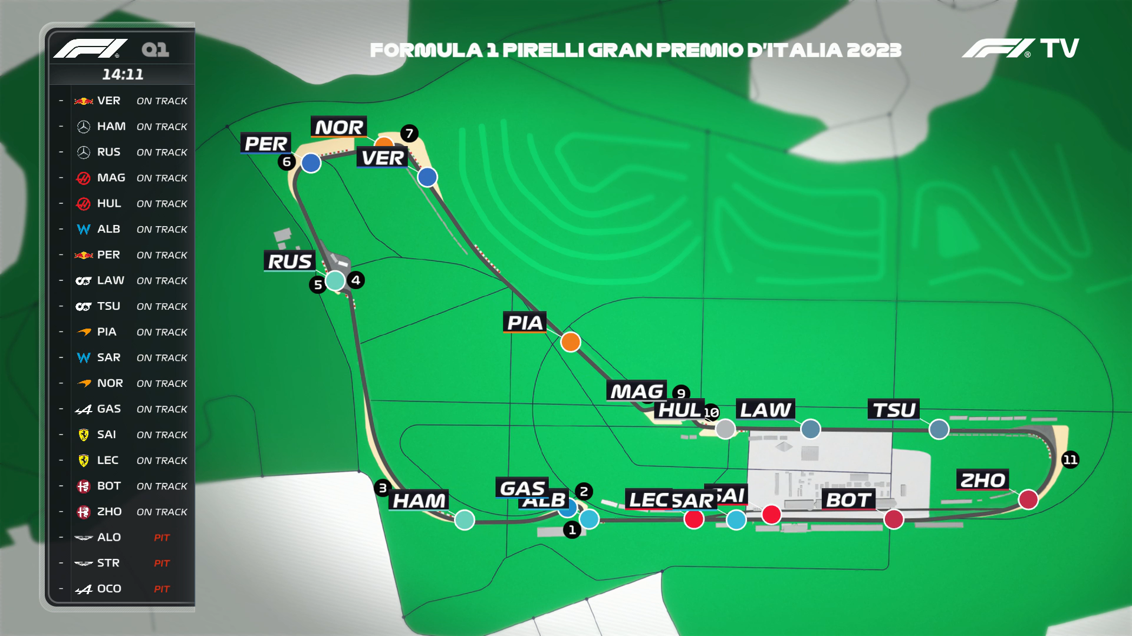
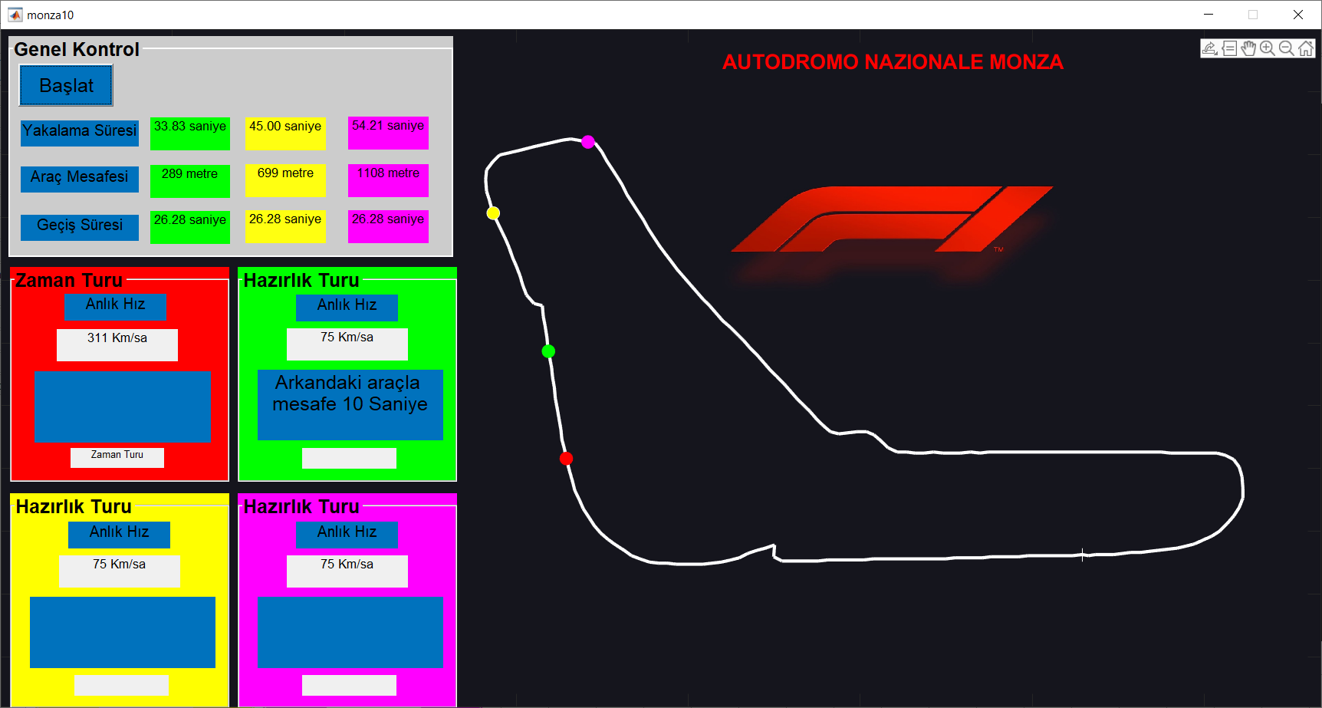
EARLY WARNING SYSTEM FOR SAFE CAR OVERTAKE IN FORMULA ONE QUALIFYING SESSION
Hüseyin Eyupcan ASLAN
Supervisor: R.A. Dr. Elif Merve KÜÇÜKÖNER
INTRODUCTION
RESULTS
Formula One is an international motorsport series that has been running continuously since 1950. Qualifying sessions, obligatory cars overtake are sometimes not possible due to traffic congestion and communication failures among drivers and the pit wall. This failures increases the risk of crash. In the 2023 season, 22 races were held and grid penalties were given 14 times to impede. By way of this the developed early warning system, a warning will be sent to the driver and pit wall 10 seconds before overtake.
In this study, obligatory overtakes between cars on fast laps and cars on out laps during Formula One Qualifying have been addressed. An automatic warning system has been developed taking into account past lap times and race safety has been enhanced during Qualifying.
MOTIVATION or PURPOSE
Formula One is an organization with high technological capabilities. Because of this the advancements in GPS systems, data transmission speed, and simulation technologies over past 20 years, the conditions of cars can be analyzed both before and during races. These conditions, which concern the field of engineering science, have created an opportunity to conduct research on Formula One. This study of aim is to increase Formula One safety by reducing the risk of crash during obligatory overtaking.
Figure 2 : Cars obligatory overtake moment
MATERIAL & METHOD
or
DESIGN
Figure 3 : Formula One apex for cars
Simulation of this study was prepared using Matlab program due to its resemblance to the graphics displayed on Formula One monitoring screens and it’s ability to process quickly. In the simulation, four markers representing the racing car are used. Red marker is on the speed lap, while the other markers are on the warm-up lap. The software operates in two stages. A warning message is broadcasted 10 seconds before overtake. The simulation is prepared according to the Monza Race Track. Sampling in the track drawing was done with the Geogebra Program.
Figure 4 : F1 TV Tracker
DISCUSSIONS
In the study, the expected results from the simulation were obtained. But, as observed in similar studies, it could only be tested through simulation. Racing simulation applications, model or mock-up construction doesn't correspond to reality. The simulation will be redeveloped using the ANSYS program to make it usable in a real race. In the future, it is intended to be submitted to the FIA
ACKNOWLEDGEMENTS
I would like to extend my heartfelt thanks to my supervisor, R.A. Dr. Elif Merve KÜÇÜKÖNER, for her invaluable contributions and guidance in the completion of this study.
Figure 1 : Matlab simulation interface
SULEYMAN DEMIREL UNIVERSITY – DEPARTMENT OF ELECTRICAL AND ELECTRONICS ENGINEERING 2023-2024 ACADEMIC YEAR GRADUATION PROJECTS EXHIBITION

